Slide 1
Stock Trading Platform
SF onboarding application
Predrag Pesic
September 2024

Slide 2

Agenda
High-level overview
Users only demo
Users with Bots demo
Services overview
Architecture
Q&A session
Dive deeper into each service
Dive deeper into each SF specific
Specification
Demo snippets
SFX snippets
Related code snippets

Slide 3
High-level overview
Microservice application
Virtual environment for stock trading
Support for 20 of the most popular stock symbols (per Google)
User can
Register and login
Review latest stock prices
Buy or sell desired amounts of desired stock symbols
Track leaderboard and rang themselves

Slide 4
High-level overview
Users interact with the SF using simple Angular client
Stock prices and leaderboard updates are propagated real-time
Application keeps track of several information
User profiles and register regions
User portfolios
User transaction history
If enabled, several bots can simulate stock trading in background
No database is running on the cluster, so it’s “per session” app

Slide 5
Application demo

Slide 6
Services overall perspective
[Stateless] Aggregator
[Stateless] Authentication
[Stateless] Leaderboard
[Stateless ASP.NET] AngularClient
[Stateless ASP.NET] PlatformAPI
[Stateless ASP.NET] RealTimeBroadcaster
[Stateful] Trading
[Stateful] UserProfile
[Reliable Actor] UserPortfolio
[Guest Executable] PythonBot

Slide 7
Services overall perspective
[Stateless] Aggregator
[Stateless] Authentication
[Stateless] Leaderboard
[Stateless ASP.NET] AngularClient
[Stateless ASP.NET] PlatformAPI
[Stateless ASP.NET] RealTimeBroadcaster
[Stateful] Trading
[Stateful] UserProfile
[Reliable Actor] UserPortfolio
[Guest Executable] PythonBot

Slide 8

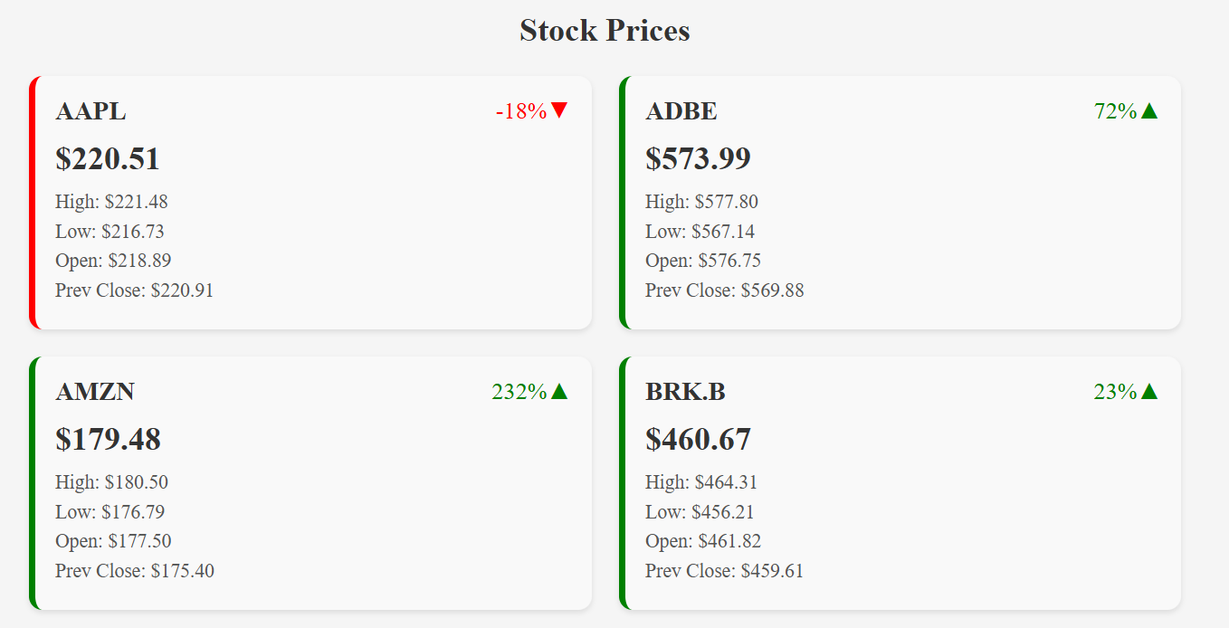
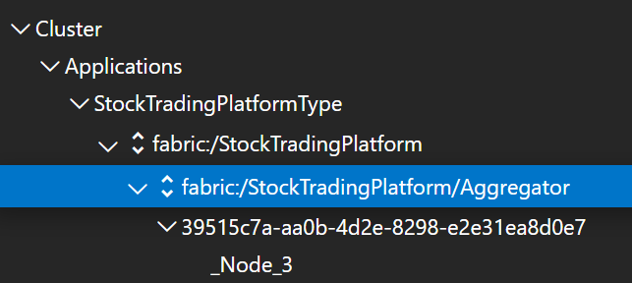
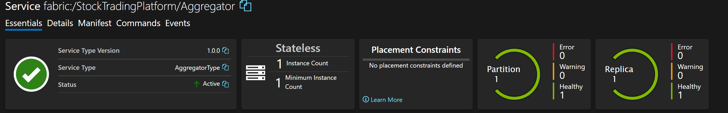
[Stateless] Aggregator
Fetches latest stock prices for 20 most popular symbols
Runs periodically, each minute
public interface IAggregator : Iservice {
Task<StockPriceModel> GetStockPriceAsync(string symbol);
Task<List<StockPriceModel>> GetAllStockPricesAsync();
Task<List<string>> GetSupportedSymbols();
}
public sealed class Aggregator : StatelessService, Iaggregator {
...
public async Task<StockPriceModel> GetStockPriceAsync(string symbol) {
return await _stockPriceService.GetStockPriceAsync(symbol);
}
public async Task<List<StockPriceModel>> GetAllStockPricesAsync() {
return await _stockPriceService.GetAllStockPricesAsync();
}
public Task<List<string>> GetSupportedSymbols() {
return Task.FromResult(_popularSymbols);
}
...
}

Slide 9
Services overall perspective
[Stateless] Aggregator
[Stateless] Authentication
[Stateless] Leaderboard
[Stateless ASP.NET] AngularClient
[Stateless ASP.NET] PlatformAPI
[Stateless ASP.NET] RealTimeBroadcaster
[Stateful] Trading
[Stateful] UserProfile
[Reliable Actor] UserPortfolio
[Guest Executable] PythonBot

Slide 10
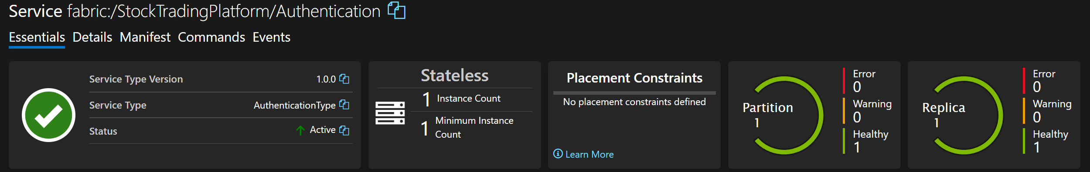
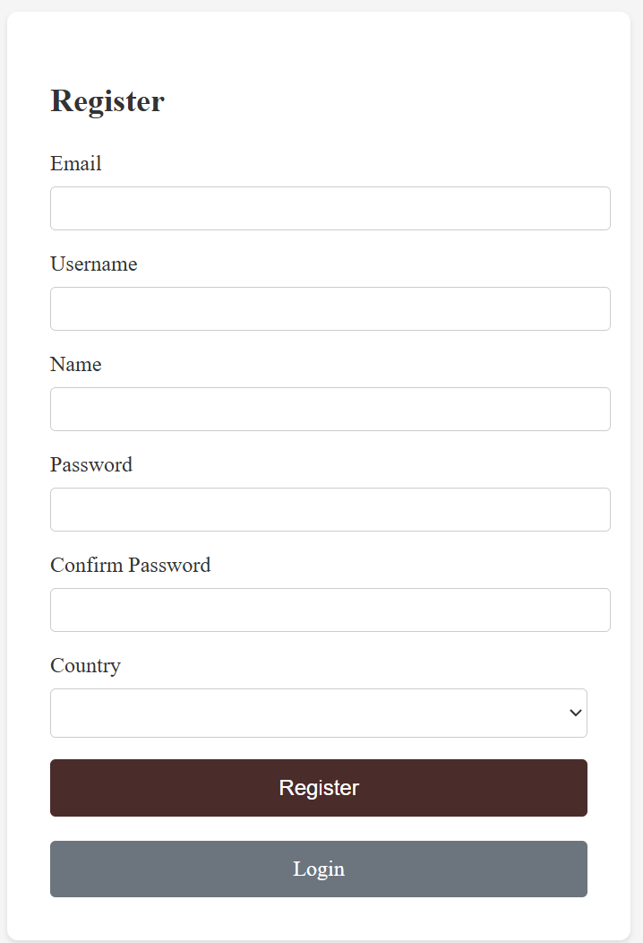
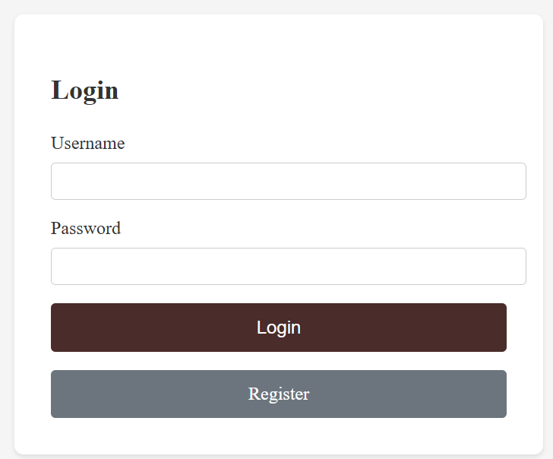
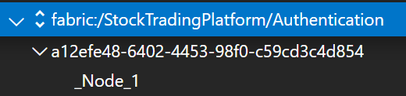
[Stateless] Authentication
Handles user requests for registration and later login
Communicates with stateful services to save generated info

Slide 11
Services overall perspective
[Stateless] Aggregator
[Stateless] Authentication
[Stateless] Leaderboard
[Stateless ASP.NET] AngularClient
[Stateless ASP.NET] PlatformAPI
[Stateless ASP.NET] RealTimeBroadcaster
[Stateful] Trading
[Stateful] UserProfile
[Reliable Actor] UserPortfolio
[Guest Executable] PythonBot

Slide 12
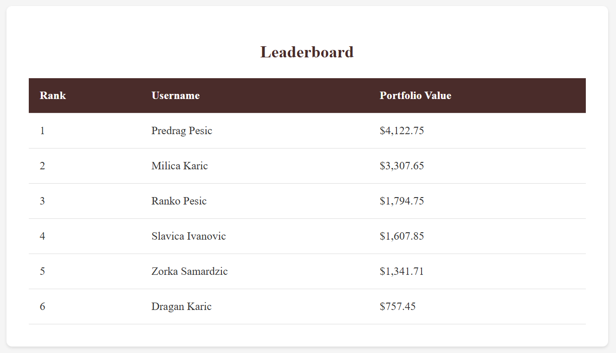
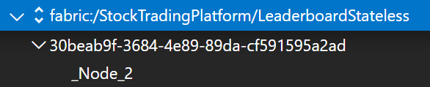

[Stateless] Leaderboard
Updates the leaderboard, ranking and sorting the users
Users are ranked based on their portfolio
Runs periodically, each ten seconds

Slide 13
Services overall perspective
[Stateless] Aggregator
[Stateless] Authentication
[Stateless] Leaderboard
[Stateless ASP.NET] AngularClient
[Stateless ASP.NET] PlatformAPI
[Stateless ASP.NET] RealTimeBroadcaster
[Stateful] Trading
[Stateful] UserProfile
[Reliable Actor] UserPortfolio
[Guest Executable] PythonBot

Slide 14
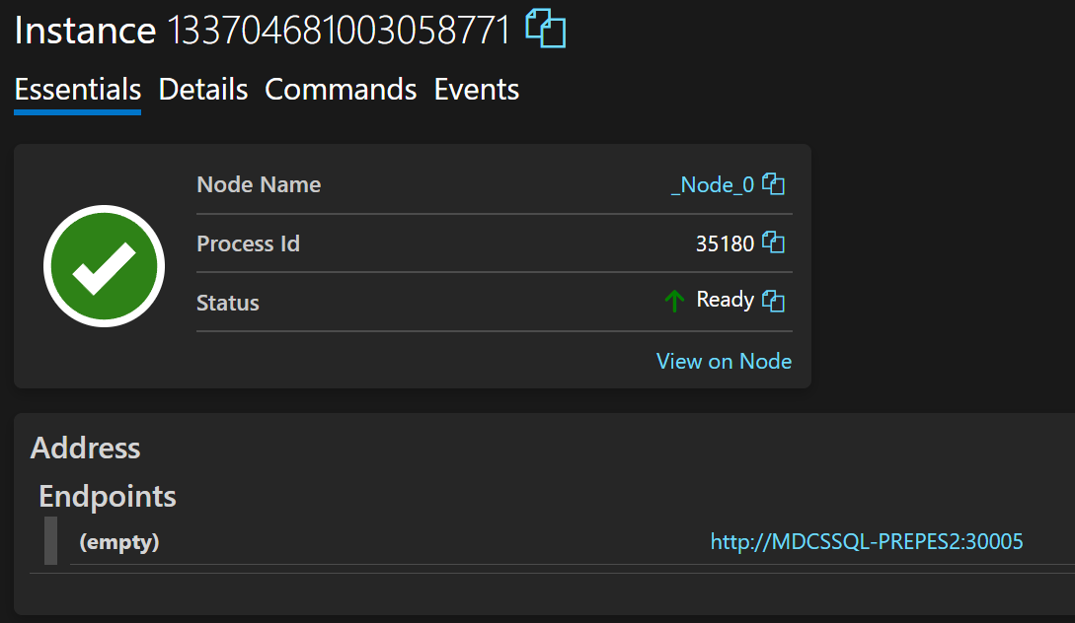
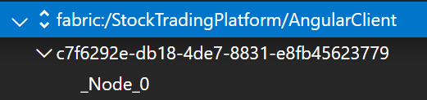
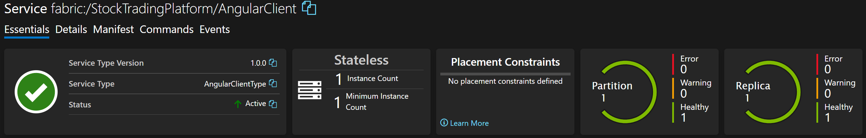
[Stateless ASP.NET] AngularClient
Frontend application packed as service on SF cluster
Alternatively, can be run externally as basic frontend app

Slide 15
Services overall perspective
[Stateless] Aggregator
[Stateless] Authentication
[Stateless] Leaderboard
[Stateless ASP.NET] AngularClient
[Stateless ASP.NET] PlatformAPI
[Stateless ASP.NET] RealTimeBroadcaster
[Stateful] Trading
[Stateful] UserProfile
[Reliable Actor] UserPortfolio
[Guest Executable] PythonBot

Slide 16
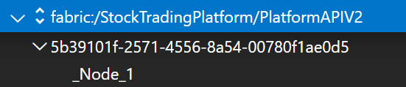
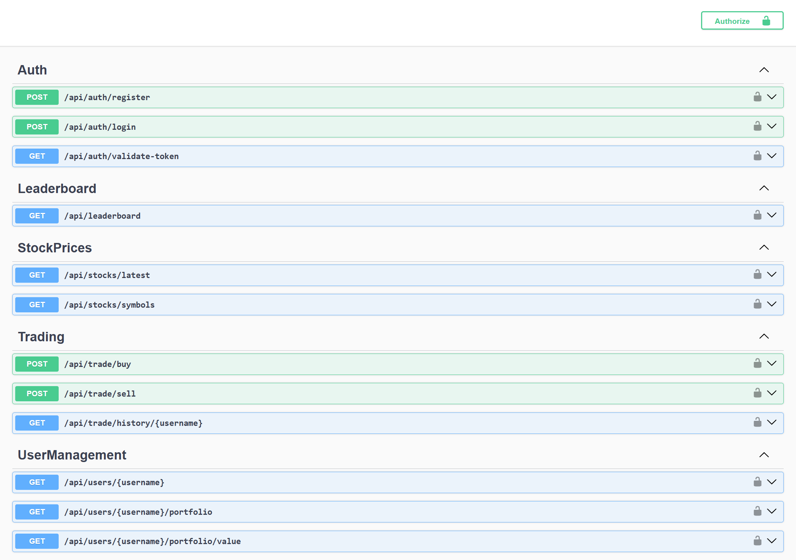
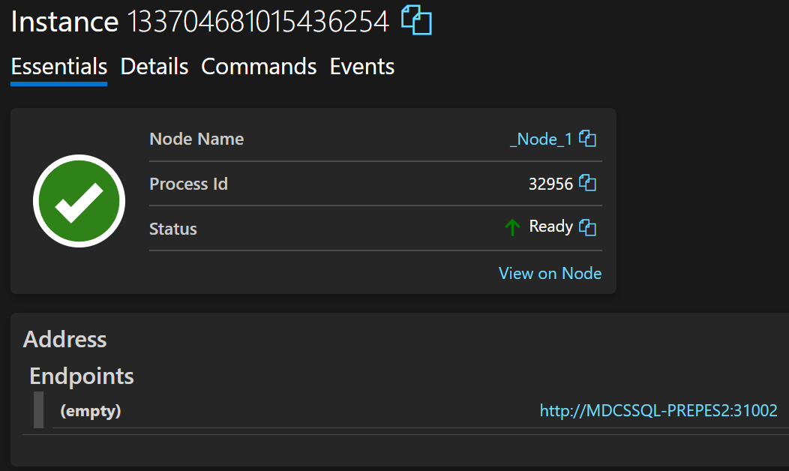

[Stateless ASP.NET] PlatformAPI
Provides and handles client communication to the cluster
Exposes HTTP endpoints for one-way communication [client -> cluster]

Slide 17
Services overall perspective
[Stateless] Aggregator
[Stateless] Authentication
[Stateless] Leaderboard
[Stateless ASP.NET] AngularClient
[Stateless ASP.NET] PlatformAPI
[Stateless ASP.NET] RealTimeBroadcaster
[Stateful] Trading
[Stateful] UserProfile
[Reliable Actor] UserPortfolio
[Guest Executable] PythonBot

Slide 18
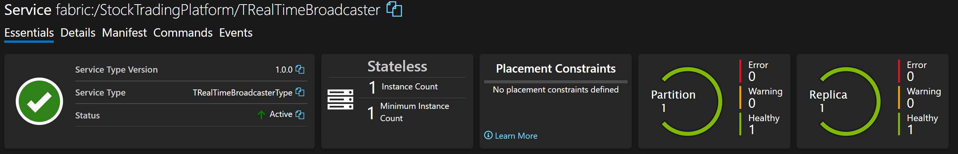
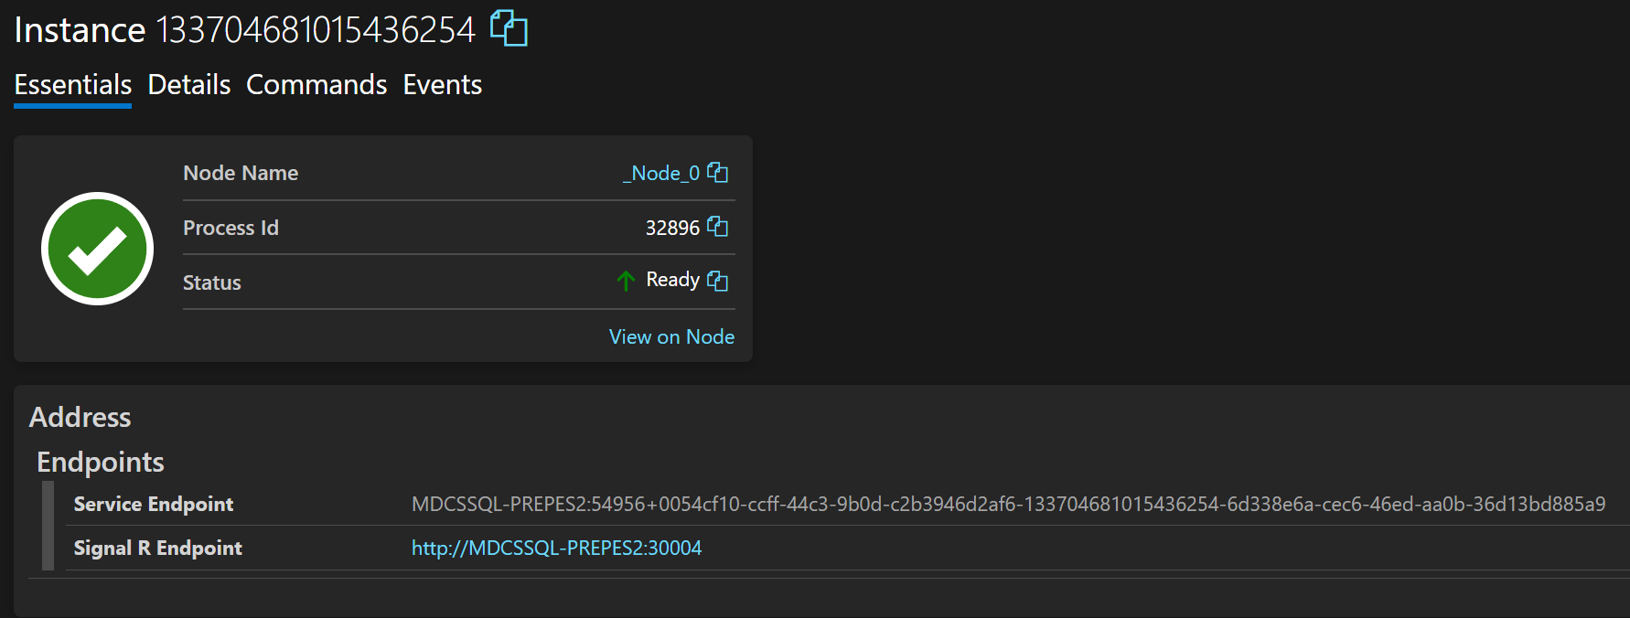
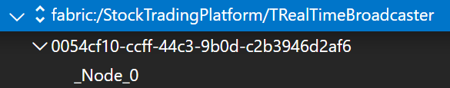
[Stateless ASP.NET] RealTimeBroadcaster
Propagates stock prices and leaderboard updates in real time
One-way communication as well, but in opposite direction [cluster -> client]

Slide 19
Services overall perspective
[Stateless] Aggregator
[Stateless] Authentication
[Stateless] Leaderboard
[Stateless ASP.NET] AngularClient
[Stateless ASP.NET] PlatformAPI
[Stateless ASP.NET] RealTimeBroadcaster
[Stateful] Trading
[Stateful] UserProfile
[Reliable Actor] UserPortfolio
[Guest Executable] PythonBot

Slide 20
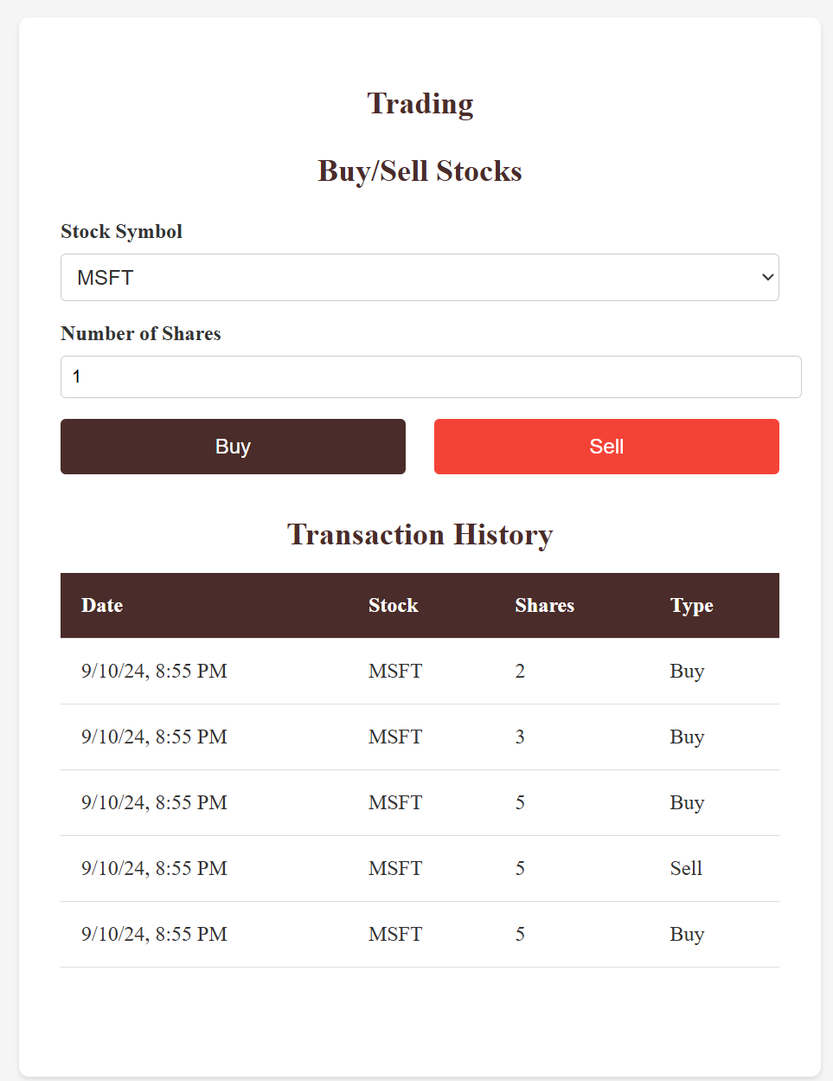
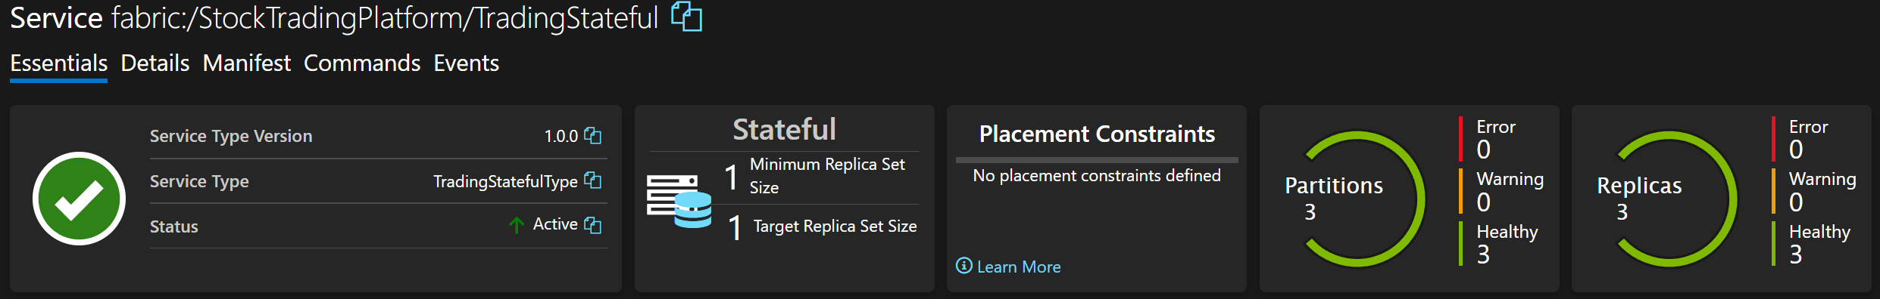
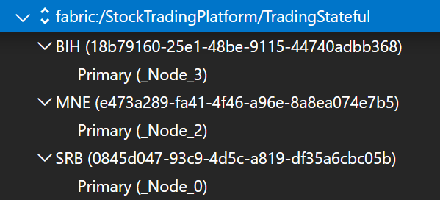
[Stateful] Trading
Uses Reliable Queue to store orders
Once order is received, it handles it appropriatelly

Slide 21
Services overall perspective
[Stateless] Aggregator
[Stateless] Authentication
[Stateless] Leaderboard
[Stateless ASP.NET] AngularClient
[Stateless ASP.NET] PlatformAPI
[Stateless ASP.NET] RealTimeBroadcaster
[Stateful] Trading
[Stateful] UserProfile
[Reliable Actor] UserPortfolio
[Guest Executable] PythonBot

Slide 22
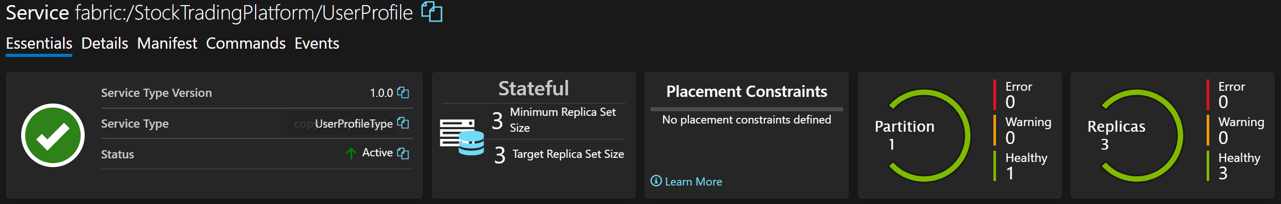
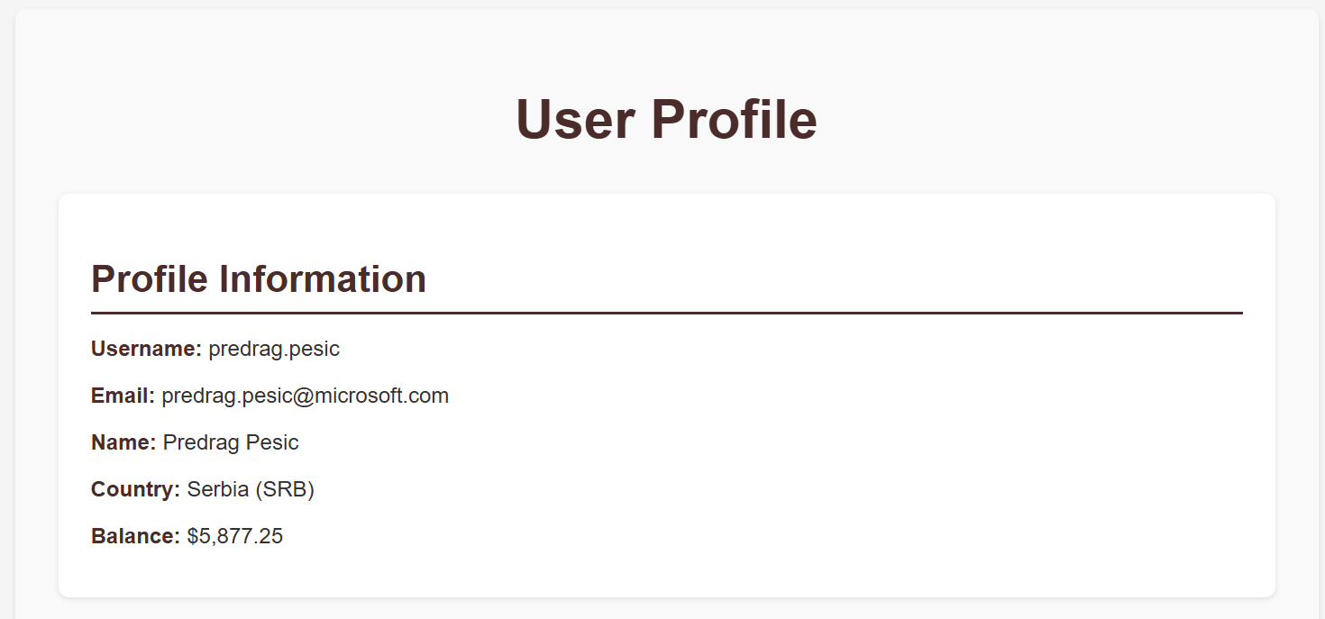
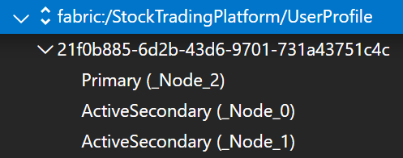
[Stateful] UserProfile
Uses Reliable Dictionary to safely store info about user
Creates initial users

Slide 23
Services overall perspective
[Stateless] Aggregator
[Stateless] Authentication
[Stateless] Leaderboard
[Stateless ASP.NET] AngularClient
[Stateless ASP.NET] PlatformAPI
[Stateless ASP.NET] RealTimeBroadcaster
[Stateful] Trading
[Stateful] UserProfile
[Reliable Actor] UserPortfolio
[Guest Executable] PythonBot

Slide 24

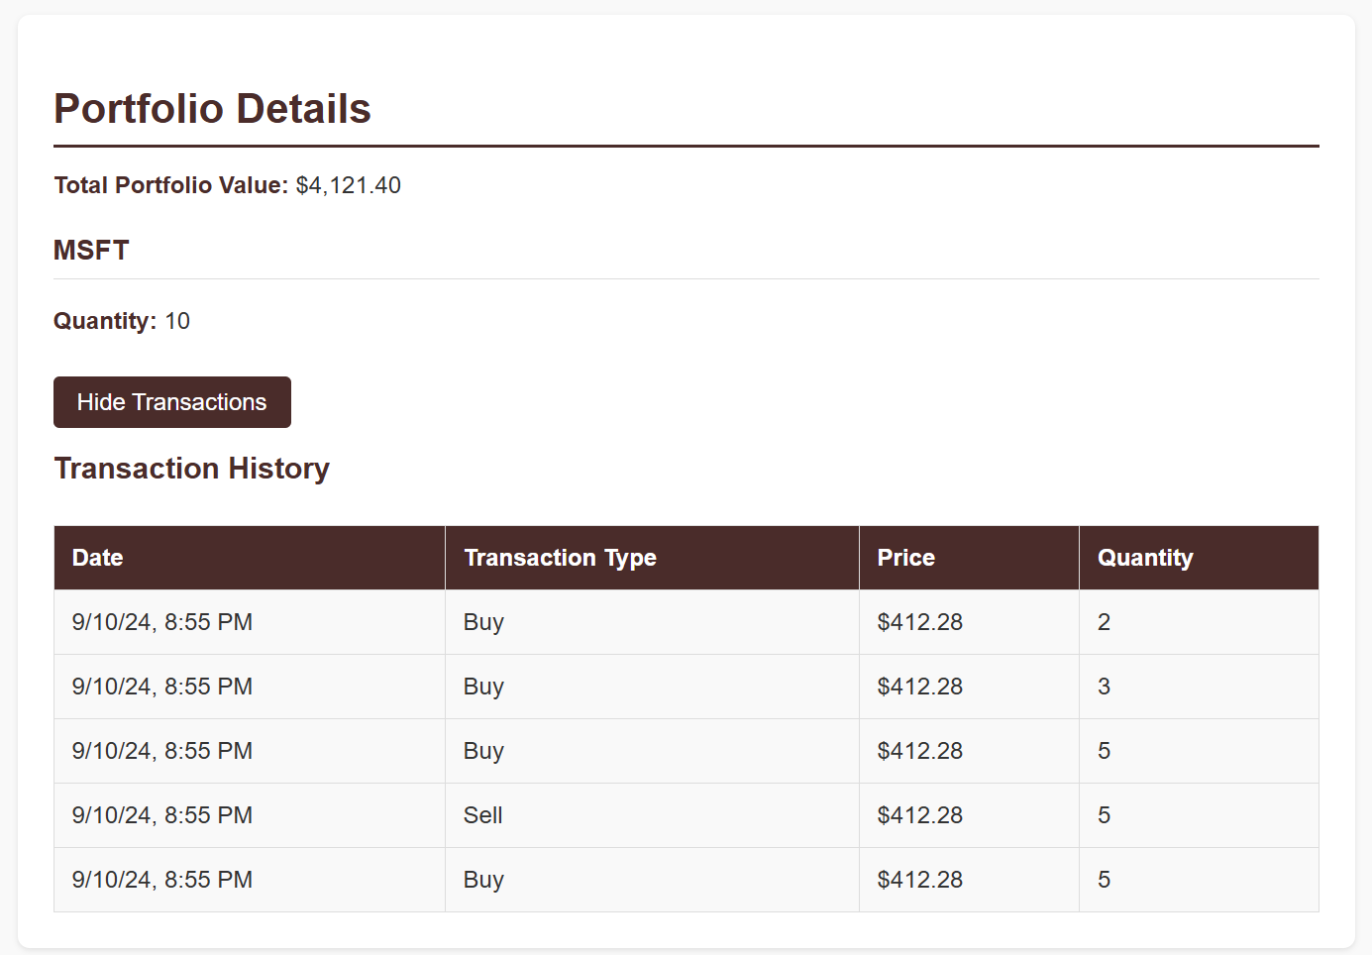
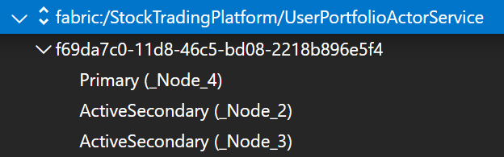
[Reliable Actor] UserPortfolio
Keeps info about user portfolio (present stock shares and values)
Separate service from UserProfile, just for the showcase

Slide 25
Services overall perspective
[Stateless] Aggregator
[Stateless] Authentication
[Stateless] Leaderboard
[Stateless ASP.NET] AngularClient
[Stateless ASP.NET] PlatformAPI
[Stateless ASP.NET] RealTimeBroadcaster
[Stateful] Trading
[Stateful] UserProfile
[Reliable Actor] UserPortfolio
[Guest Executable] PythonBot

Slide 26

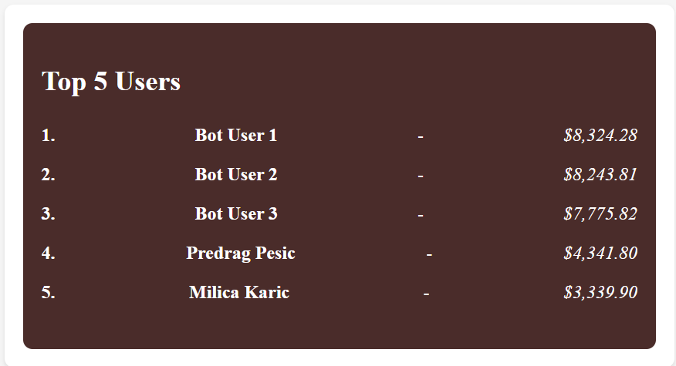
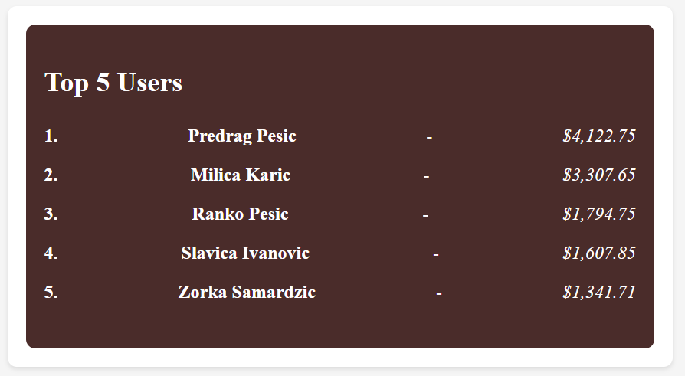
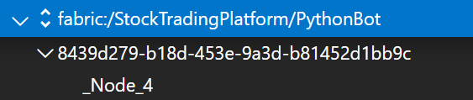
[Guest Executable] PythonBot
Simulates registration and login of three users
After it, randomly and periodically buys/sells stocks

Slide 27
Architecture
* Blue communication – HTTP
* Other communication – RPC
Trading
Aggregator
RealTime Broadcaster
UserProfile
Leaderboard
AngularClient
UserPortfolio
Authentication
PlatformAPI
PythonBot

Slide 28
SF specifics and quick overview
Usage of Failover Manager
Failover of Failover Manager
Reverse proxy
Affinity & placement constraints
Resource governance & custom metrics Auto-scaling & overload
Upgrade, rollback & service versioning Local deployment via SF cmdlets
Cloud deployment & chaos testing

Slide 29
SF specifics and quick overview
Usage of Failover Manager
Failover of Failover Manager
Reverse proxy
Affinity & placement constraints
Resource governance & custom metrics Auto-scaling & overload
Upgrade, rollback & service versioning Local deployment via SF cmdlets
Cloud deployment & chaos testing

Slide 30
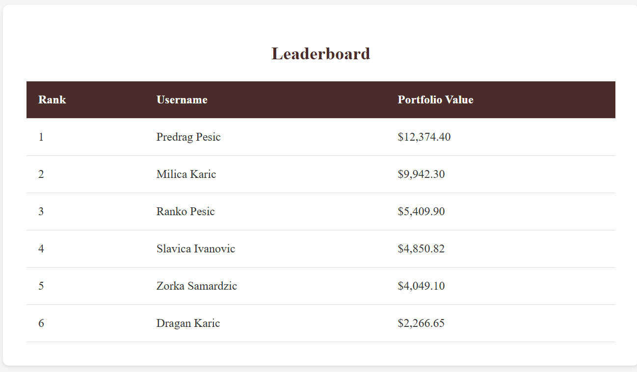
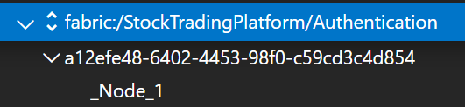
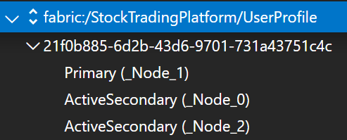
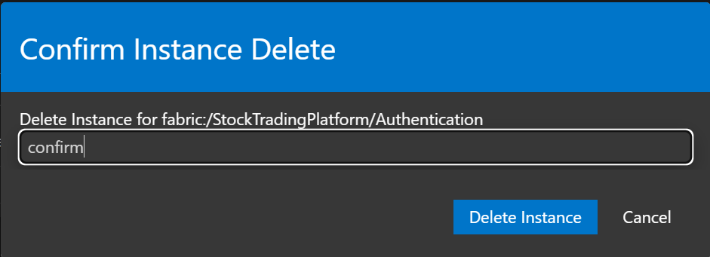

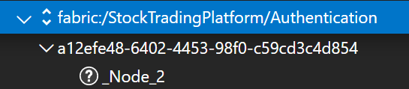
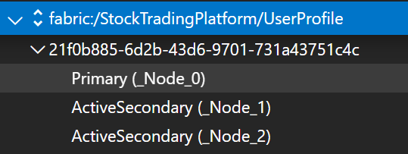
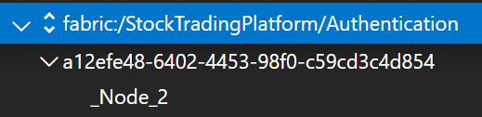
Usage of Failover Manager

Slide 31
SF specifics and quick overview
Usage of Failover Manager
Failover of Failover Manager
Reverse proxy
Affinity & placement constraints
Resource governance & custom metrics Auto-scaling & overload
Upgrade, rollback & service versioning Local deployment via SF cmdlets
Cloud deployment & chaos testing

Slide 32
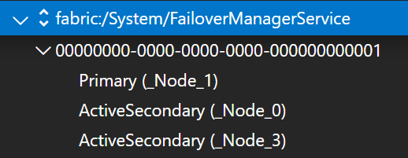

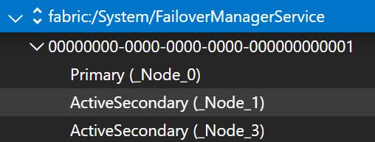
Failover of Failover Manager

Slide 33
SF specifics and quick overview
Usage of Failover Manager
Failover of Failover Manager
Reverse proxy
Affinity & placement constraints
Resource governance & custom metrics Auto-scaling & overload
Upgrade, rollback & service versioning Local deployment via SF cmdlets
Cloud deployment & chaos testing

Slide 34
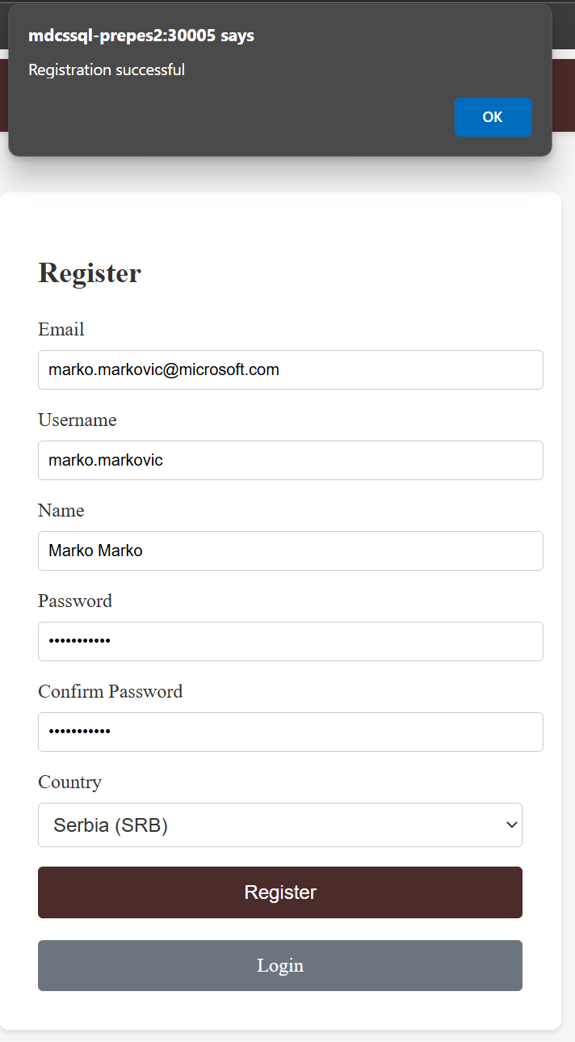
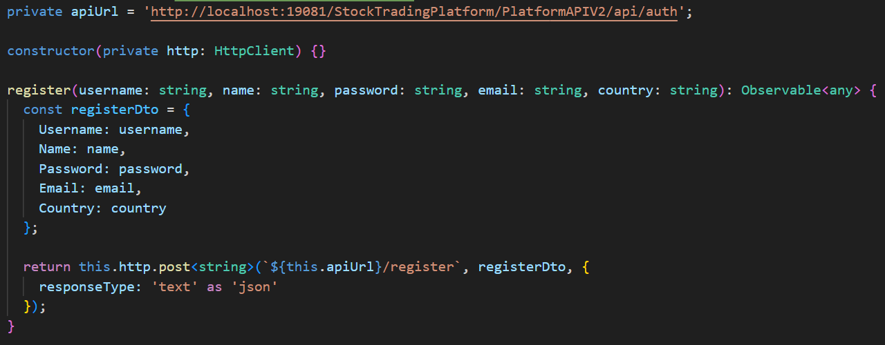
Reverse proxy

Slide 35
SF specifics and quick overview
Usage of Failover Manager
Failover of Failover Manager
Reverse proxy
Affinity & placement constraints
Resource governance & custom metrics Auto-scaling & overload
Upgrade, rollback & service versioning Local deployment via SF cmdlets
Cloud deployment & chaos testing

Slide 36
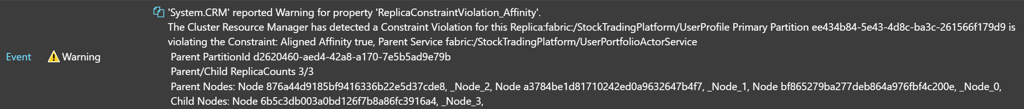
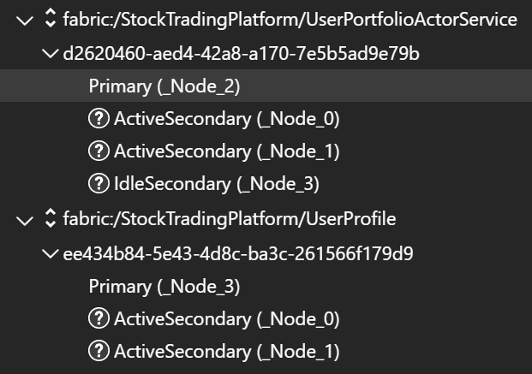
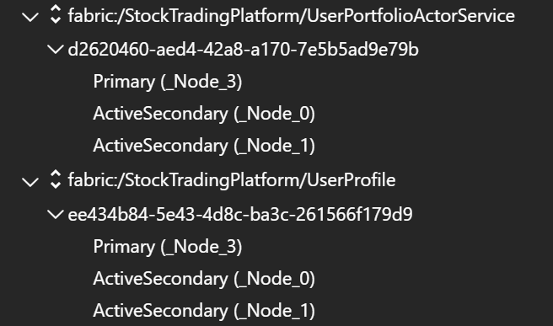
Affinity & placement constraints
private async Task DefineDescription() {
FabricClient fabricClient = new FabricClient();
StatefulServiceUpdateDescription updateDescription = new();
DefineAffinity(updateDescription);
await fabricClient.ServiceManager.UpdateServiceAsync(Context.ServiceName, updateDescription);
}
private void DefineAffinity(StatefulServiceUpdateDescription updateDescription) {
ServiceCorrelationDescription serviceCorrelationDescription = new();
serviceCorrelationDescription.Scheme = ServiceCorrelationScheme.Affinity;
serviceCorrelationDescription.ServiceName = new Uri("fabric:/StockTradingPlatform/UserPortfolioActorService");
updateDescription.Correlations ??= new List<ServiceCorrelationDescription>();
updateDescription.Correlations.Add(serviceCorrelationDescription);
}
protected override async Task OnOpenAsync(ReplicaOpenMode openMode, CancellationToken cancellationToken) {
await DefineDescription();
ServiceEventSource.Current.ServiceMessage(this.Context, $"{this.Context.NodeContext.NodeName}: UserProfile");
await base.OnOpenAsync(openMode, cancellationToken);
}

Slide 37
SF specifics and quick overview
Usage of Failover Manager
Failover of Failover Manager
Reverse proxy
Affinity & placement constraints
Resource governance & custom metrics Auto-scaling & overload
Upgrade, rollback & service versioning Local deployment via SF cmdlets
Cloud deployment & chaos testing

Slide 38
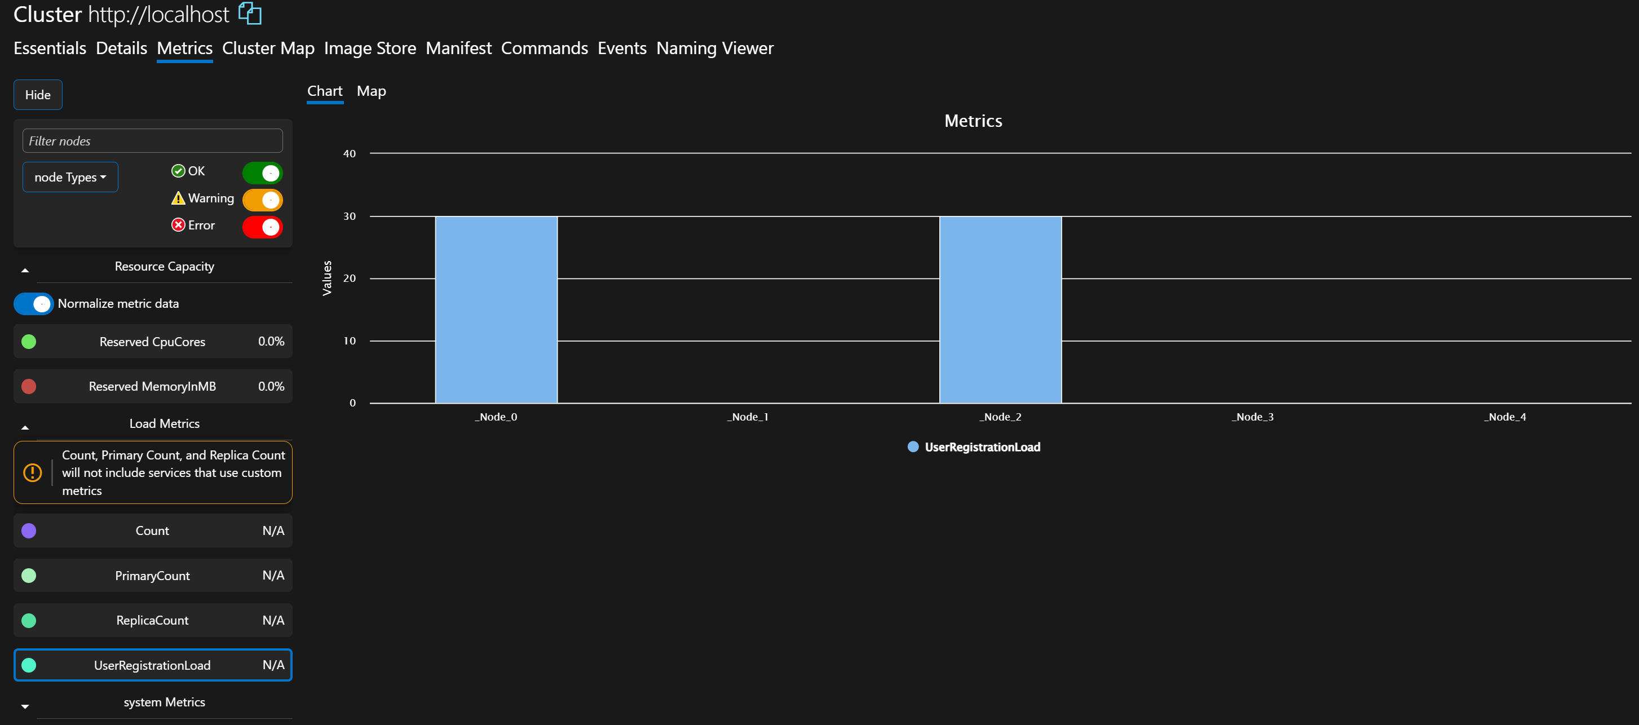
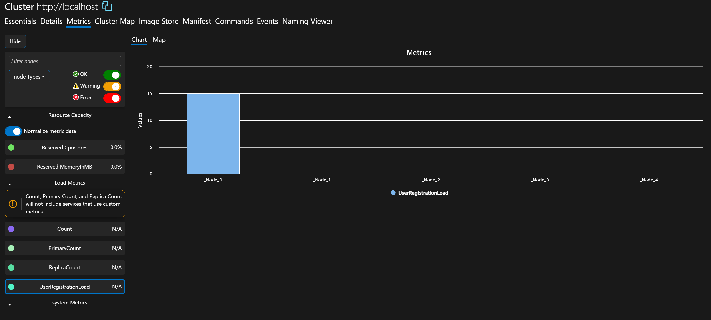
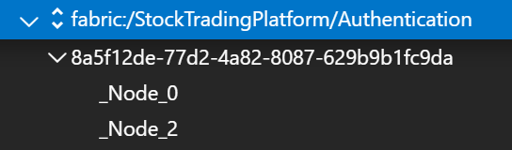
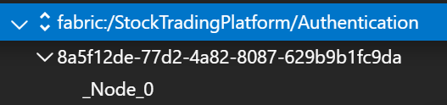
Resource governance & custom metrics Auto-scaling & overload
private async Task DefineDescription() {
FabricClient fabricClient = new FabricClient();
StatelessServiceUpdateDescription updateDescription = new();
DefineCustomMetrics(updateDescription);
DefineAutoScaling(updateDescription);
await fabricClient.ServiceManager.UpdateServiceAsync(Context.ServiceName, updateDescription);
}
private void DefineCustomMetrics(StatelessServiceUpdateDescription updateDescription) {
var userLoadMetric = new StatelessServiceLoadMetricDescription {
Name = "UserRegistrationLoad",
DefaultLoad = _initLoad,
Weight = ServiceLoadMetricWeight.High
};
updateDescription.Metrics ??= new MetricsCollection();
updateDescription.Metrics.Add(userLoadMetric);
}
protected override async Task OnOpenAsync(CancellationToken cancellationToken) {
await DefineDescription();
ServiceEventSource.Current.ServiceMessage(this.Context, $"{this.Context.NodeContext.NodeName} opened with service: Authentication");
await base.OnOpenAsync(cancellationToken);
}
private void ReportCustomMetric(int loadValue) {
var loadMetrics = new List<LoadMetric> {
new LoadMetric("UserRegistrationLoad", loadValue)
};
ServiceEventSource.Current.ServiceMessage(this.Context, $"Reported custom metric: UserRegistrationLoad with value {loadValue}");
Partition.ReportLoad(loadMetrics); }
{
"name": "ReconfigurationAgent",
"parameters": [
…
{
"name": "SendLoadReportInterval",
"value": "30"
}
]
}
private void DefineAutoScaling(StatelessServiceUpdateDescription updateDescription) {
PartitionInstanceCountScaleMechanism partitionInstanceCountScaleMechanism = new PartitionInstanceCountScaleMechanism {
MinInstanceCount = 1,
MaxInstanceCount = 4,
ScaleIncrement = 1
};
AveragePartitionLoadScalingTrigger averagePartitionLoadScalingTrigger = new AveragePartitionLoadScalingTrigger {
MetricName = "UserRegistrationLoad",
LowerLoadThreshold = 10.0,
UpperLoadThreshold = 20.0,
ScaleInterval = TimeSpan.FromSeconds(60)
};
ScalingPolicyDescription scalingPolicyDescription = new ScalingPolicyDescription(
partitionInstanceCountScaleMechanism, averagePartitionLoadScalingTrigger);
updateDescription.ScalingPolicies ??= new List<ScalingPolicyDescription>();
updateDescription.ScalingPolicies.Add(scalingPolicyDescription);
}

Slide 39
SF specifics and quick overview
Usage of Failover Manager
Failover of Failover Manager
Reverse proxy
Affinity & placement constraints
Resource governance & custom metrics Auto-scaling & overload
Upgrade, rollback & service versioning Local deployment via SF cmdlets
Cloud deployment & chaos testing

Slide 40
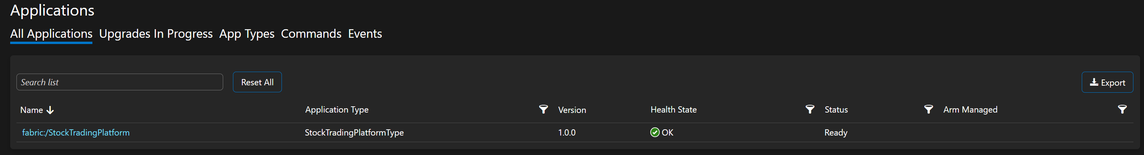
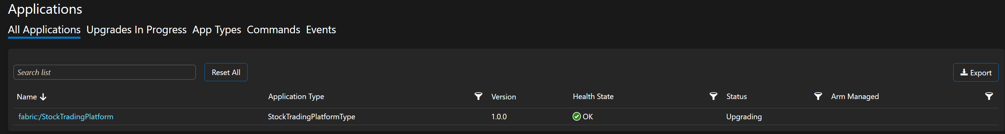
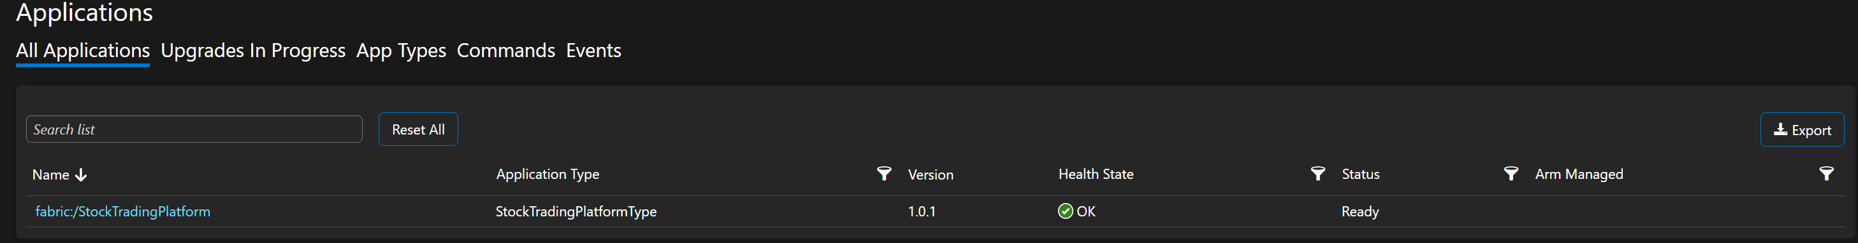
Upgrade, rollback & service versioning Local deployment via SF cmdlets
<DefaultServices>
<Service Name="AngularClient" ServicePackageActivationMode="ExclusiveProcess">
<StatelessService ServiceTypeName="AngularClientType">
<SingletonPartition />
</StatelessService>
</Service>
...
<Service Name="TradingStateful" ServicePackageActivationMode="ExclusiveProcess">
<StatefulService ServiceTypeName="TradingStatefulType">
<NamedPartition>
<Partition Name="SRB" />
<Partition Name="MNE" />
<Partition Name="BIH" />
</NamedPartition>
</StatefulService>
</Service>
...
</DefaultServices>

Slide 41
SF specifics and quick overview
Usage of Failover Manager
Failover of Failover Manager
Reverse proxy
Affinity & placement constraints
Resource governance & custom metrics Auto-scaling & overload
Upgrade, rollback & service versioning Local deployment via SF cmdlets
Cloud deployment & chaos testing

Slide 42
Cloud deployment & chaos testing

Slide 43
Q&A

Slide 44

Thank you!

